Slide 1
Chapter 10
Break Song

Slide 2
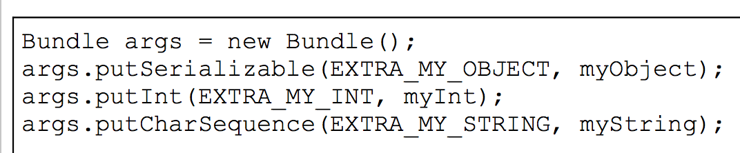
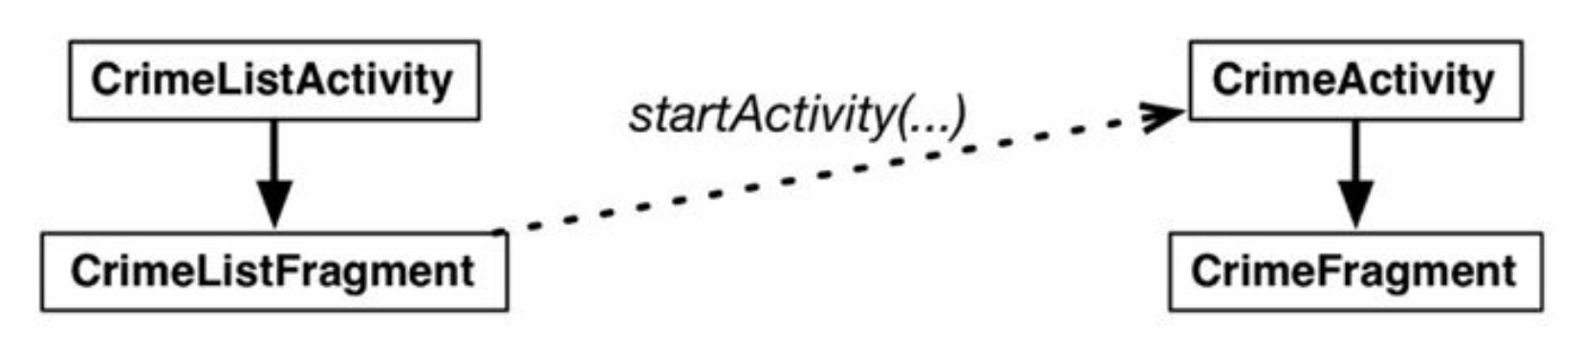
Fragmentr/Activity間傳值
用Intent傳值
(Fragment受Activity綁定)
用Bundle傳值
(Fragment不受Activity綁定）

Slide 3
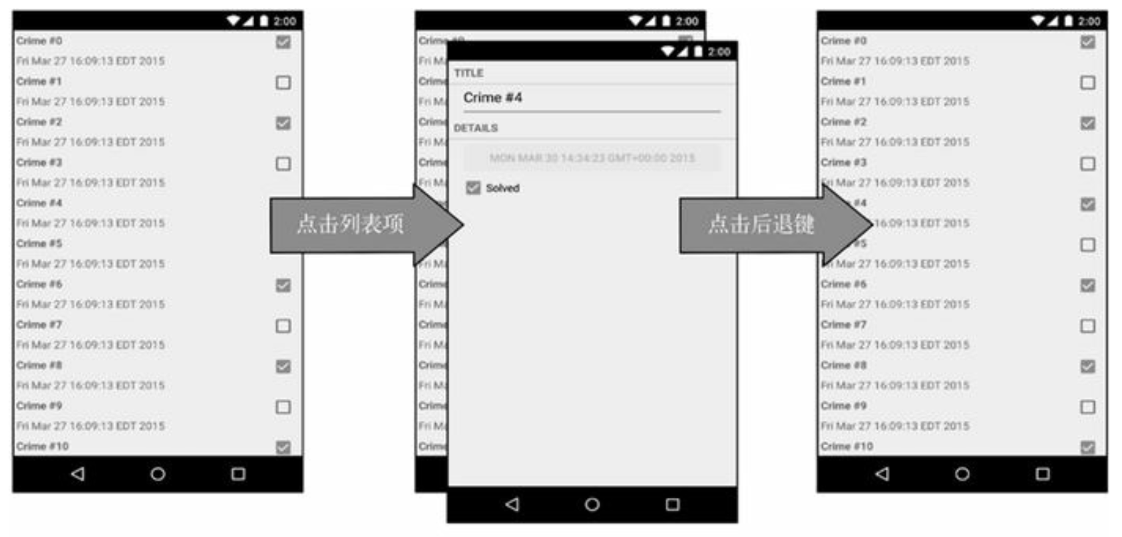
Process

Slide 4
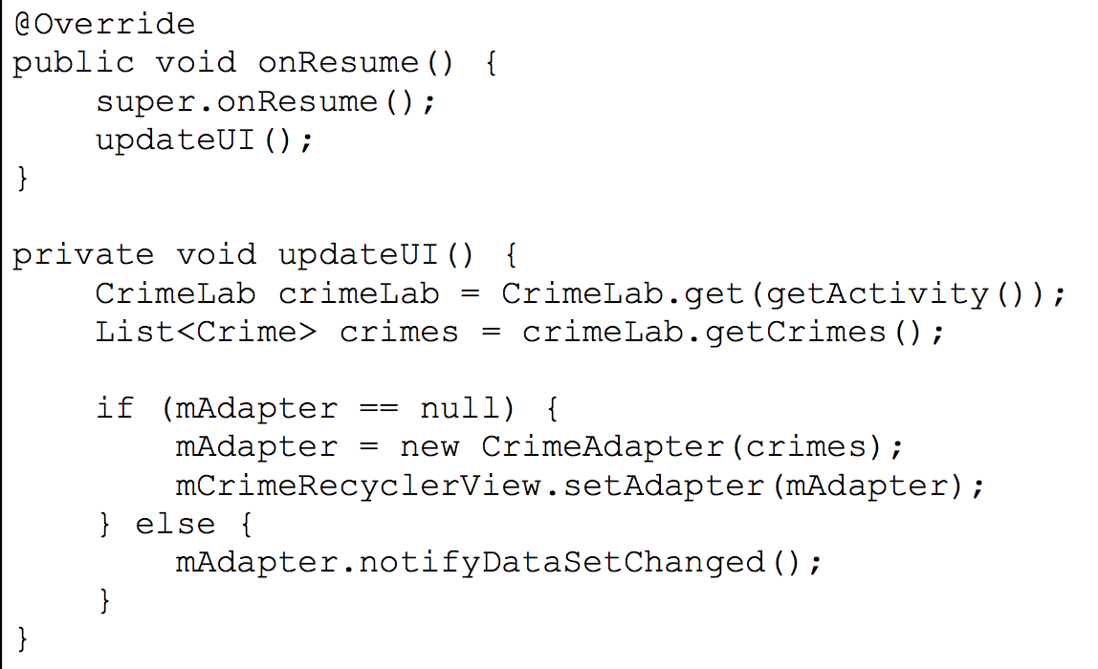
Back鍵

Slide 5
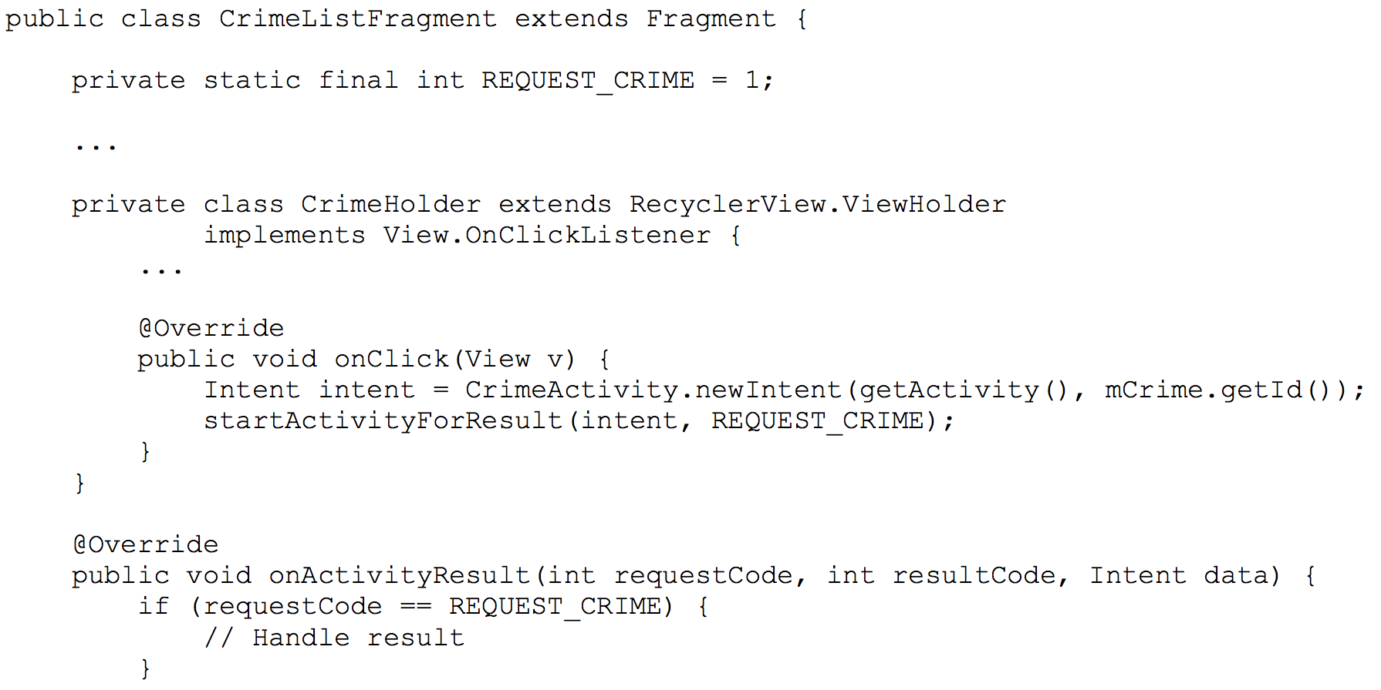
Fragment.startActivityForResult
取代先前的Activity.startActivityForResult

Slide 6
Chapter 20
Break Song

Slide 7
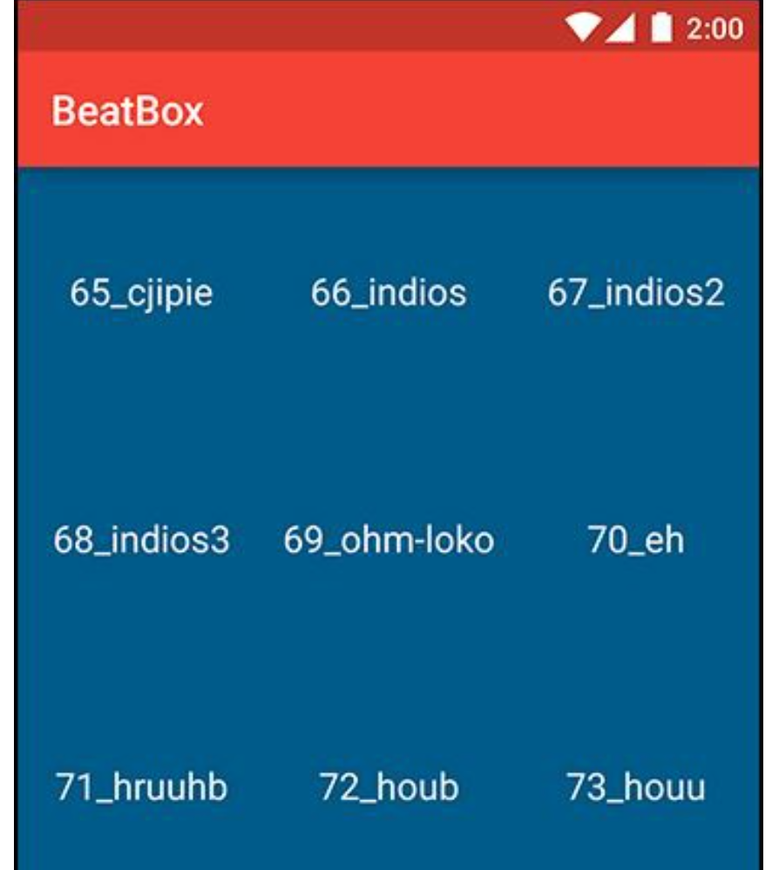
Example

Slide 8
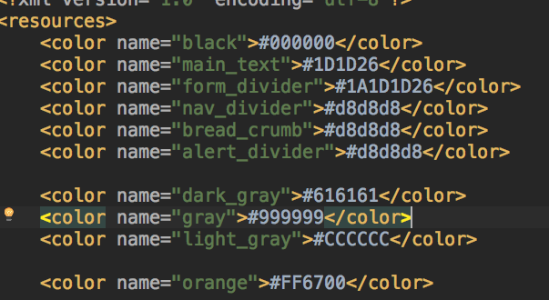
Color
Define RGB value in “/res/values/color.xml”

Slide 9
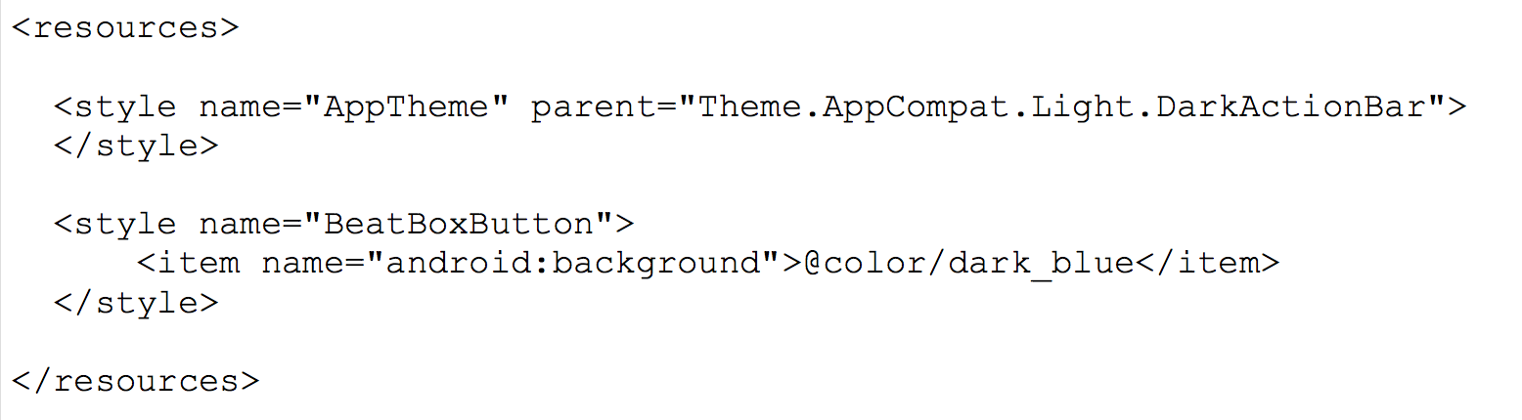
Style
Define style in /res/values/styles.xml

Slide 10
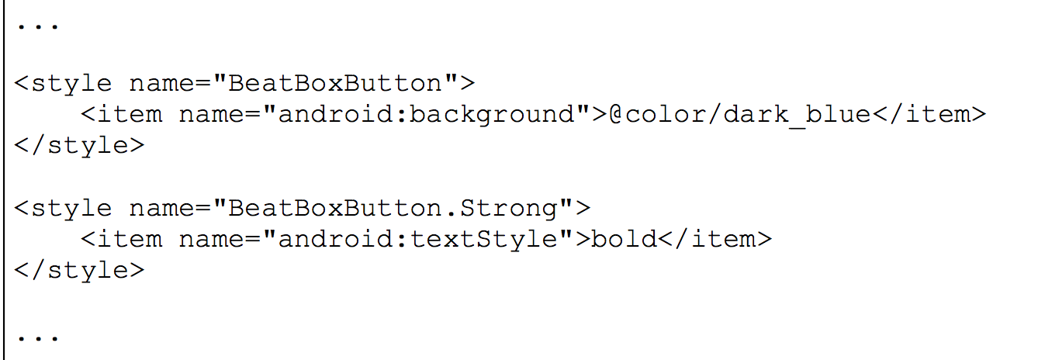
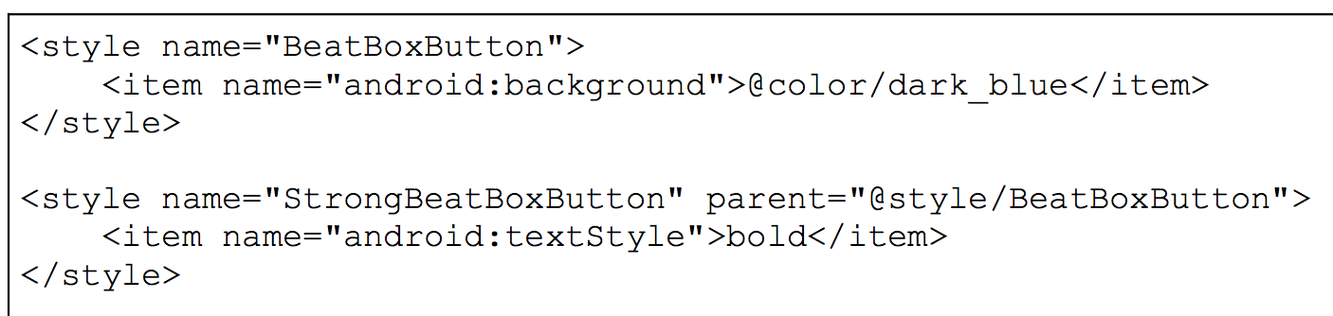
Style inherent / Parent

Slide 11
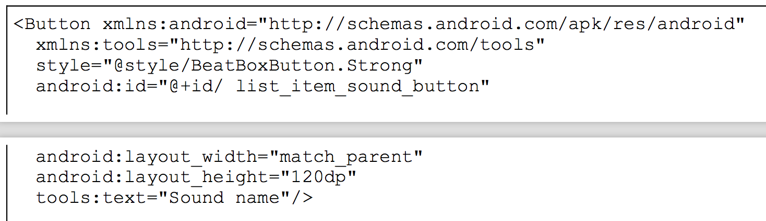
Example

Slide 12
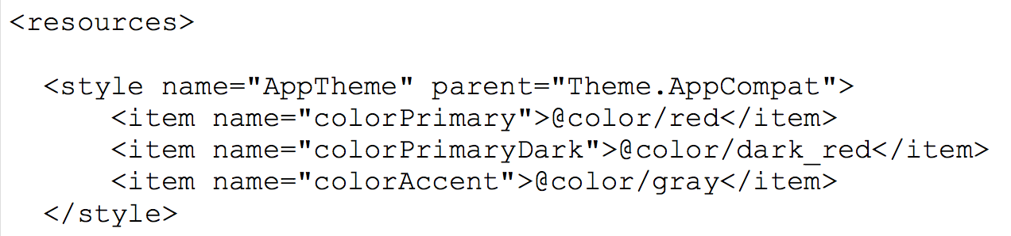
Theme

Slide 13
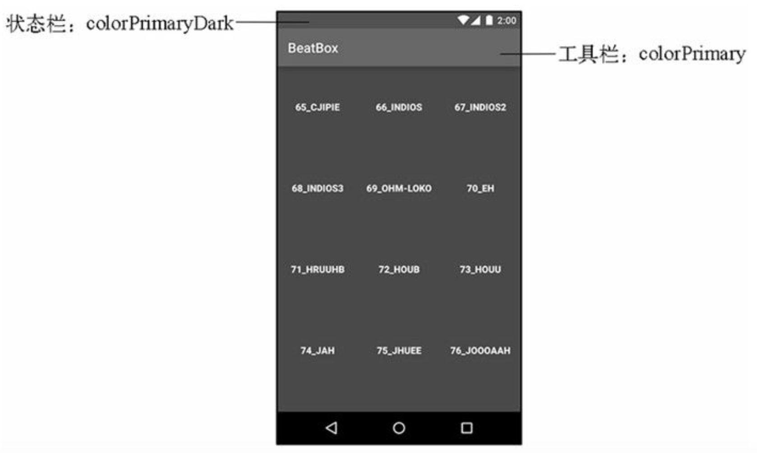
Theme

Slide 14
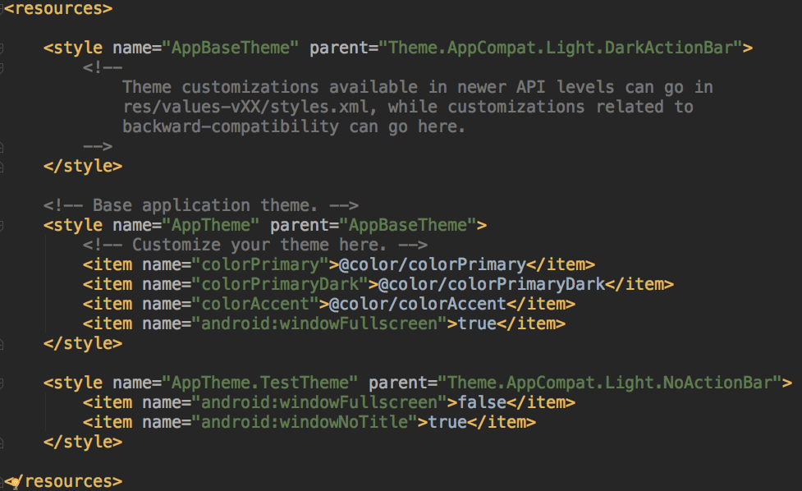
Both inherent and parent
Notes:
http://stackoverflow.com/questions/12614707/android-xml-theme-inheriting-from-two-parent-themes

Slide 15
Both inherent and parent
TestTheme <- Theme.AppComapt.Light.NoActionBar <- Theme.AppComapt.Light
If parent="Theme.AppComapt.Light.NoActionBar" removed:
TestTheme <- AppTheme <- AppBaseTheme <- Theme.AppComapt.Light.DarkActionBar hierarchy is in place.
So parent="..." seems to take definitely precedence. AppTheme.TestTheme does not inherit from both parents at once.

